Slide 1
Day 4

Slide 2

Case Study 1: Get all employee detail from Employee Detail table whose "FirstName" start with any single character between 'a-p'

Slide 3
Solution: Get all employee detail from EmployeeDetail table whose "FirstName" start with any single character between 'a-p'
ANS: MS SQL Server: SELECT * FROM EmployeeDetail WHERE FirstName like ‘[a-p]%’

Slide 4
Get all employee detail from Employee. Detail table whose "FirstName" not start with any single character between 'a-p’
Case Study 2:

Slide 5
Get all employee detail from EmployeeDetail table whose "FirstName" not start with any single character between 'a-p’
Case Study 2:

Slide 6
Find all users with first names not ending with letters between n–s.
Case Study 3:

Slide 7
Find all users with first names not ending with letters between n–s.
Solution
SELECT * FROM users WHERE first_name LIKE ‘%[^n-s]'

Slide 8
Create table First:
-- Create the Product table with the StateProvinceCode column
CREATE TABLE Product (
ProductID INT PRIMARY KEY,
ProductNumber VARCHAR(10),
StateProvinceCode VARCHAR(2) -- Add the StateProvinceCode column
);
-- Insert 10 random values into the table
INSERT INTO Product (ProductID, ProductNumber, StateProvinceCode)
VALUES
(1, 'LA-123', 'CA'),
(2, 'LB-456', 'NY'),
(3, 'LC-789', 'TX'),
(4, 'LD-135', 'FL'),
(5, 'LE-246', 'CA'),
(6, 'LF-357', 'NY'),
(7, 'LG-999', 'TX'),
(8, 'LH-123', 'FL'),
(9, 'LI-456', 'CA'),
(10, 'LJ-789', 'NY'),
(11, 'LK-246', 'TX'),
(12, 'LL-357', 'FL'),
(13, 'LM-999', 'CA'),
(14, 'LN-123', 'NY'),
(15, 'LO-456', 'TX'),
(16, 'LP-789', 'FL'),
(17, 'LQ-135', 'CA'),
(18, 'LR-246', 'NY'),
(19, 'LS-357', 'TX'),
(20, 'LT-999', 'FL');
-- Insert 10 random values into the table
INSERT INTO Product (ProductID, ProductNumber, StateProvinceCode)
VALUES
(121, 'LK-246', 'TX'),
(122, 'LL-357', 'FL'),
(123, 'LM-999', 'CA'),
(124, 'LN-123', 'NY'),
(125, 'LO-456', 'TX'),
(126, 'LP-789', 'FL'),
(127, 'LQ-135', 'CA'),
(128, 'LR-246', 'NY'),
(129, 'LS-357', 'TX'),
(220, 'LT-999', 'FL');

Slide 9
Create table First:
CREATE TABLE Location (
LocationID INT PRIMARY KEY,
StateProvinceCode VARCHAR(2),
City VARCHAR(50),
ZipCode VARCHAR(10)
);
INSERT INTO Location (LocationID, StateProvinceCode, City, ZipCode)
VALUES
(12, 'CP', 'Los Angeles', '90001'),
(23, 'NP', 'New York', '10001'),
(34, 'TC', 'Houston', '77001'),
(45, 'FK', 'Miami', '33101'),
(57, 'IO', 'Chicago', '60601'),
(68, 'WA', 'Seattle', '98101'),
(71, 'MI', 'Boston', '02101'),
(82, 'GW', 'Atlanta', '30301'),
(93, 'CQ', 'Denver', '80201'),
(101, 'AC', 'Phoenix', '85001');

Slide 10
-- INNER JOIN
SELECT *
FROM Product
INNER JOIN Location ON Product.StateProvinceCode = Location.StateProvinceCode;
-- LEFT JOIN
SELECT *
FROM Product
LEFT JOIN Location ON Product.StateProvinceCode = Location.StateProvinceCode;
-- RIGHT JOIN
SELECT *
FROM Product
RIGHT JOIN Location ON Product.StateProvinceCode = Location.StateProvinceCode;
-- FULL OUTER JOIN
SELECT *
FROM Product
FULL OUTER JOIN Location ON Product.StateProvinceCode = Location.StateProvinceCode;
-- CROSS JOIN
SELECT *
FROM Product
CROSS JOIN Location;

Slide 11
String:
SELECT *
FROM StateProvince
WHERE StateProvinceCode LIKE 'A[BKL]';

Slide 12
String:
SELECT *
FROM Product
WHERE StateProvinceCode LIKE 'A[BKL]’;
In this pattern, 'A[BKL]', the [BKL] part represents a character class or character set, which means that it will match any single character that is either
'B', 'K', or 'L' after the letter 'A'. So, it will select rows where the StateProvinceCode starts with 'A' followed by either 'B', 'K', or 'L’.
StateProvinceCode | StateProvinceName
----------------- | -----------------
AB | Alberta
AK | Alaska
AL | Alabama
CA | California

Slide 13
String:
SELECT *
FROM Product
--WHERE ProductNumber LIKE 'L%';
WHERE ProductNumber LIKE 'L[A-Z]-[0-9]%'
SELECT *
FROM Product
--WHERE ProductNumber LIKE 'L%';
--WHERE ProductNumber LIKE 'L[A-Z]-[0-9]%'
WHERE ProductNumber LIKE 'L[I-N]-[135]%';

Slide 14
String:
SELECT CHARINDEX('D','DAD');
SELECT CHARINDEX('D','DAD',2);
SELECT ProductNumber
FROM Product
SELECT ProductNumber, CHARINDEX('I', ProductNumber)
FROM Product
SELECT ProductNumber, CHARINDEX('I', ProductNumber)
FROM Product
WHERE ProductNumber LIKE '%I%';

Slide 15
String:
SELECT ProductNumber, datalength(ProductNumber)
FROM Product
SELECT FORMAT(20200616,'####/##/##');

Slide 16
String:
SELECT ProductNumber, left(ProductNumber,2) AS ExtractNameFromLeft
FROM Product
SELECT ProductNumber, right(ProductNumber,2) AS ExtractNameFromRight
FROM Product
SELECT FirstName,LEN(FirstName) AS ExtractLengthOfName
FROM Person.Person;

Slide 17
String:
SELECT ProductNumber, datalength(ProductNumber) AS ExtractLength,
len(ProductNumber) AS ExtractLength_
FROM Product
DATALENGTH(ProductNumber) calculates the length of the ProductNumber column in bytes, including trailing spaces. This will give you the length of the data as it is stored in the database.
LEN(ProductNumber) calculates the length of the ProductNumber column in characters. It counts the number of characters in the string, excluding trailing spaces.
The difference between these two numbers for each row will be the number of trailing spaces in the ProductNumber column. If there are no trailing spaces, the two numbers will be the same.

Slide 18
String:
SELECT FirstName, LOWER(FirstName) AS LowerFName
FROM Person.Person;
SELECT FirstName, UPPER(FirstName) AS LowerFName
FROM Person.Person;
SELECT Ltrim(' Trim Left Side');
SELECT rtrim('Trim Left Side ');
SELECT trim(' Trim Both The Sides ');

Slide 19
String:
SELECT Name, PATINDEX('%Ball%',Name)
FROM Production.Product
WHERE Name LIKE '%Ball%';
SELECT Name, Patindex('%Cr_nk%',Name)
FROM Production.Product
WHERE Name LIKE '%Cr%';
SELECT LoginID, REPLACE(LoginID,'adventure-works','aw') AS ReplaceString
FROM HumanResources.Employee;
SELECT FirstName, REPLICATE(FirstName,3) AS ReplicateFName
FROM Person.Person;

Slide 20
String:
SELECT FirstName, REVERSE(FirstName) AS ReverseFName
FROM Person.Person;
SELECT Top 100 LastName, Substring(LastName,3,5) AS SubstringLName
FROM Person.Person
ORDER BY LastName;
SELECT ProductNumber,str(ProductID) AS ExtractNameFromRight
FROM Product --To convert into String

Slide 21
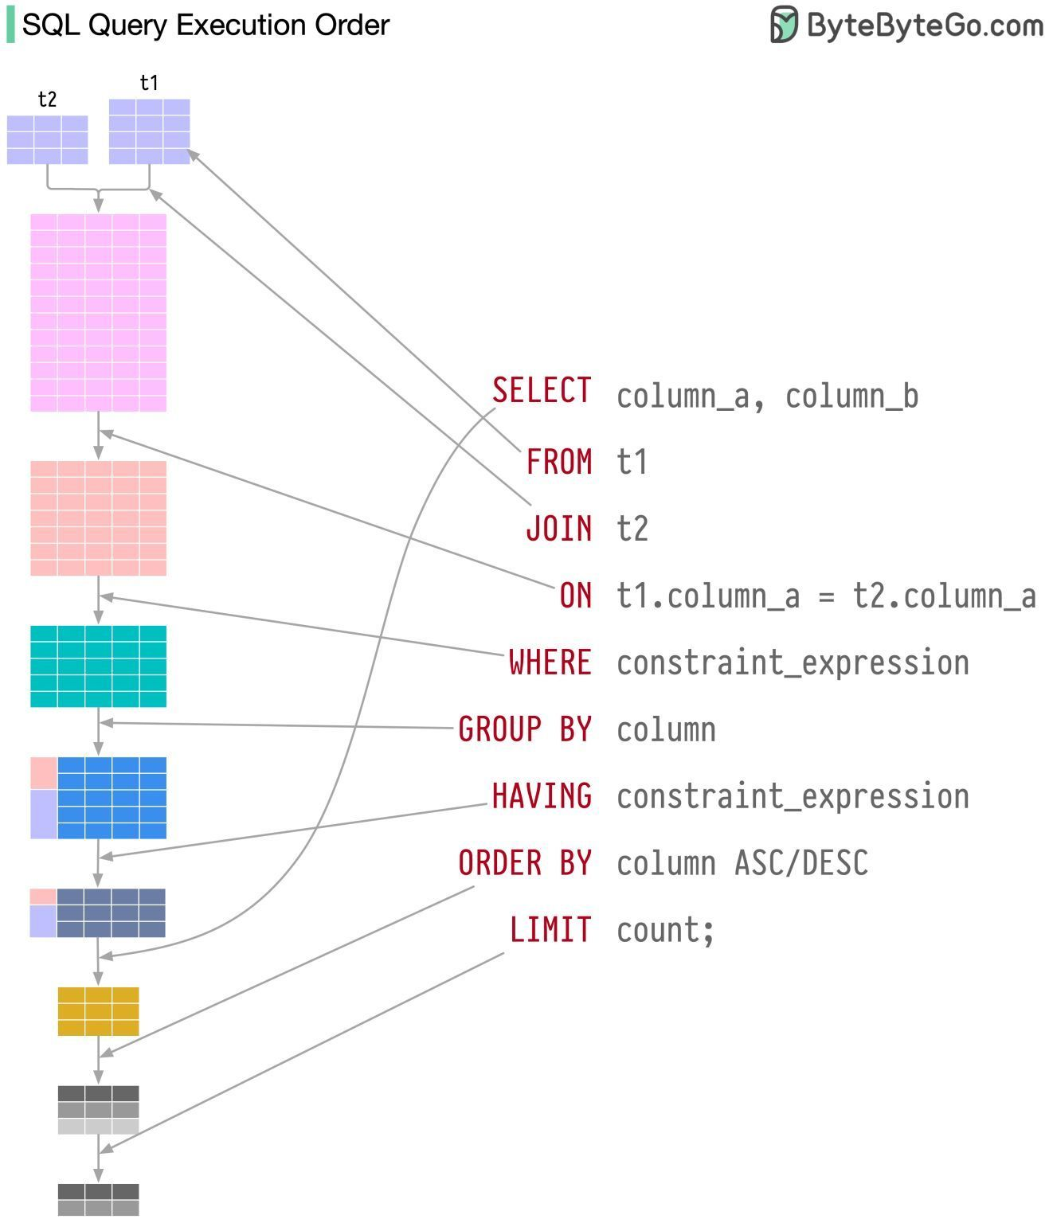

Slide 22
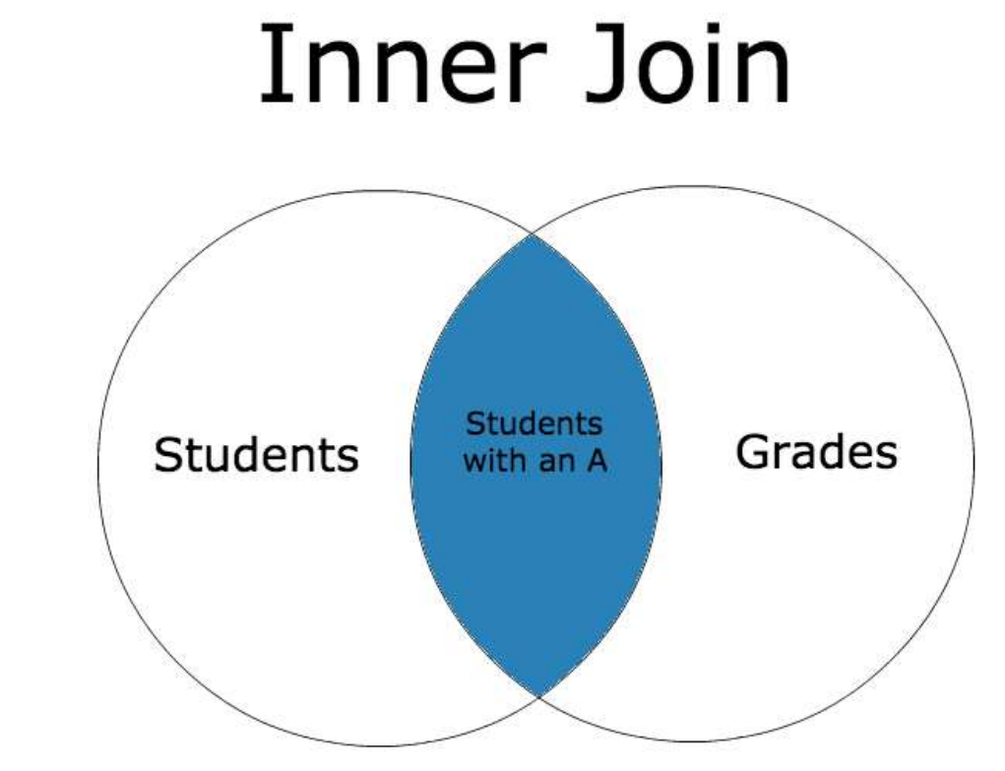

Slide 23
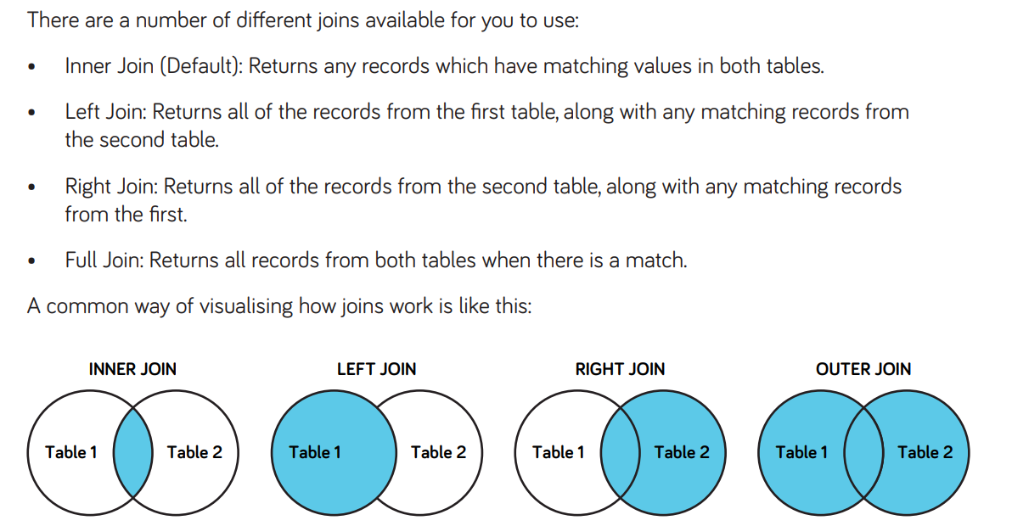

Slide 24
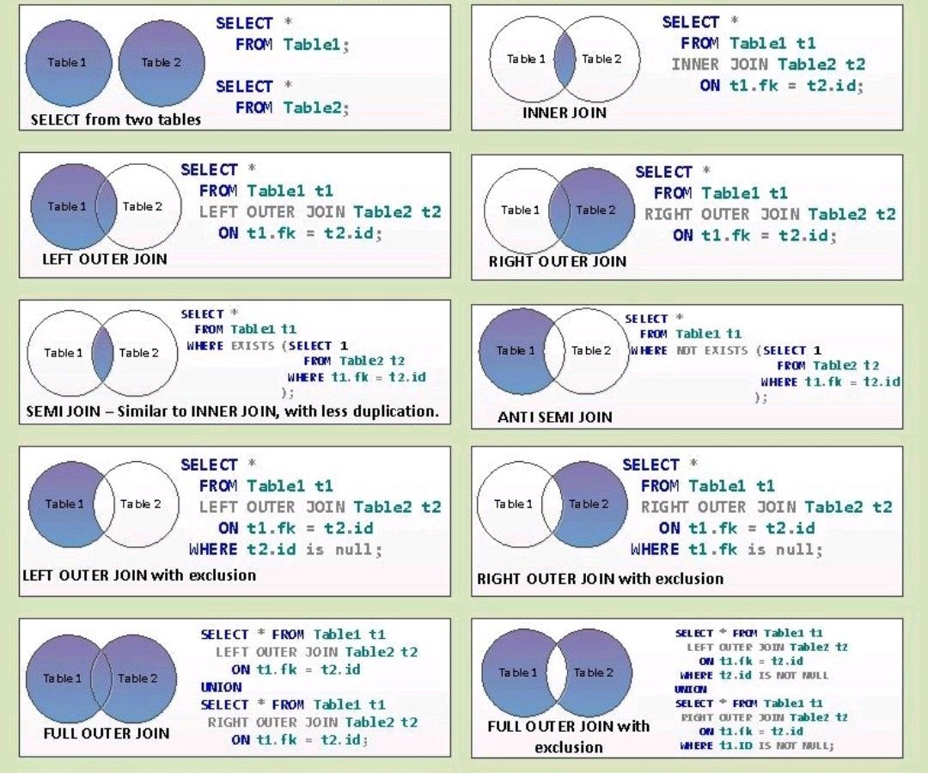

Slide 25


Slide 26
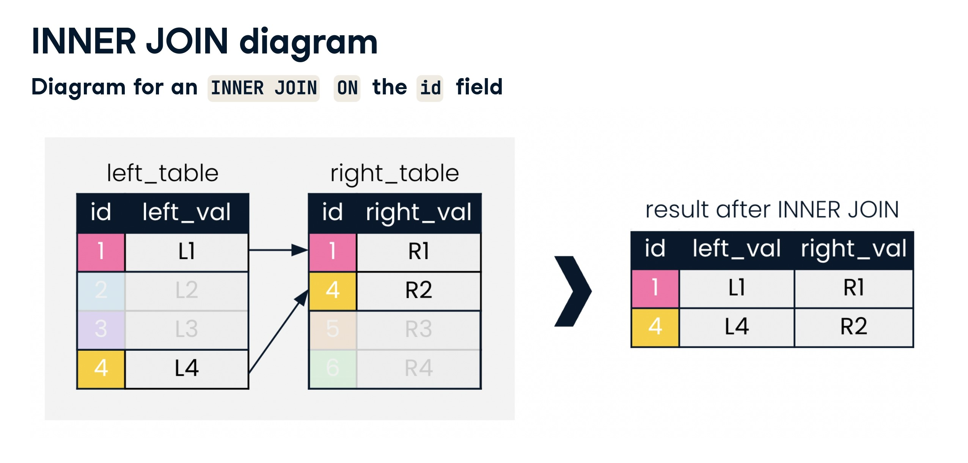

Slide 27
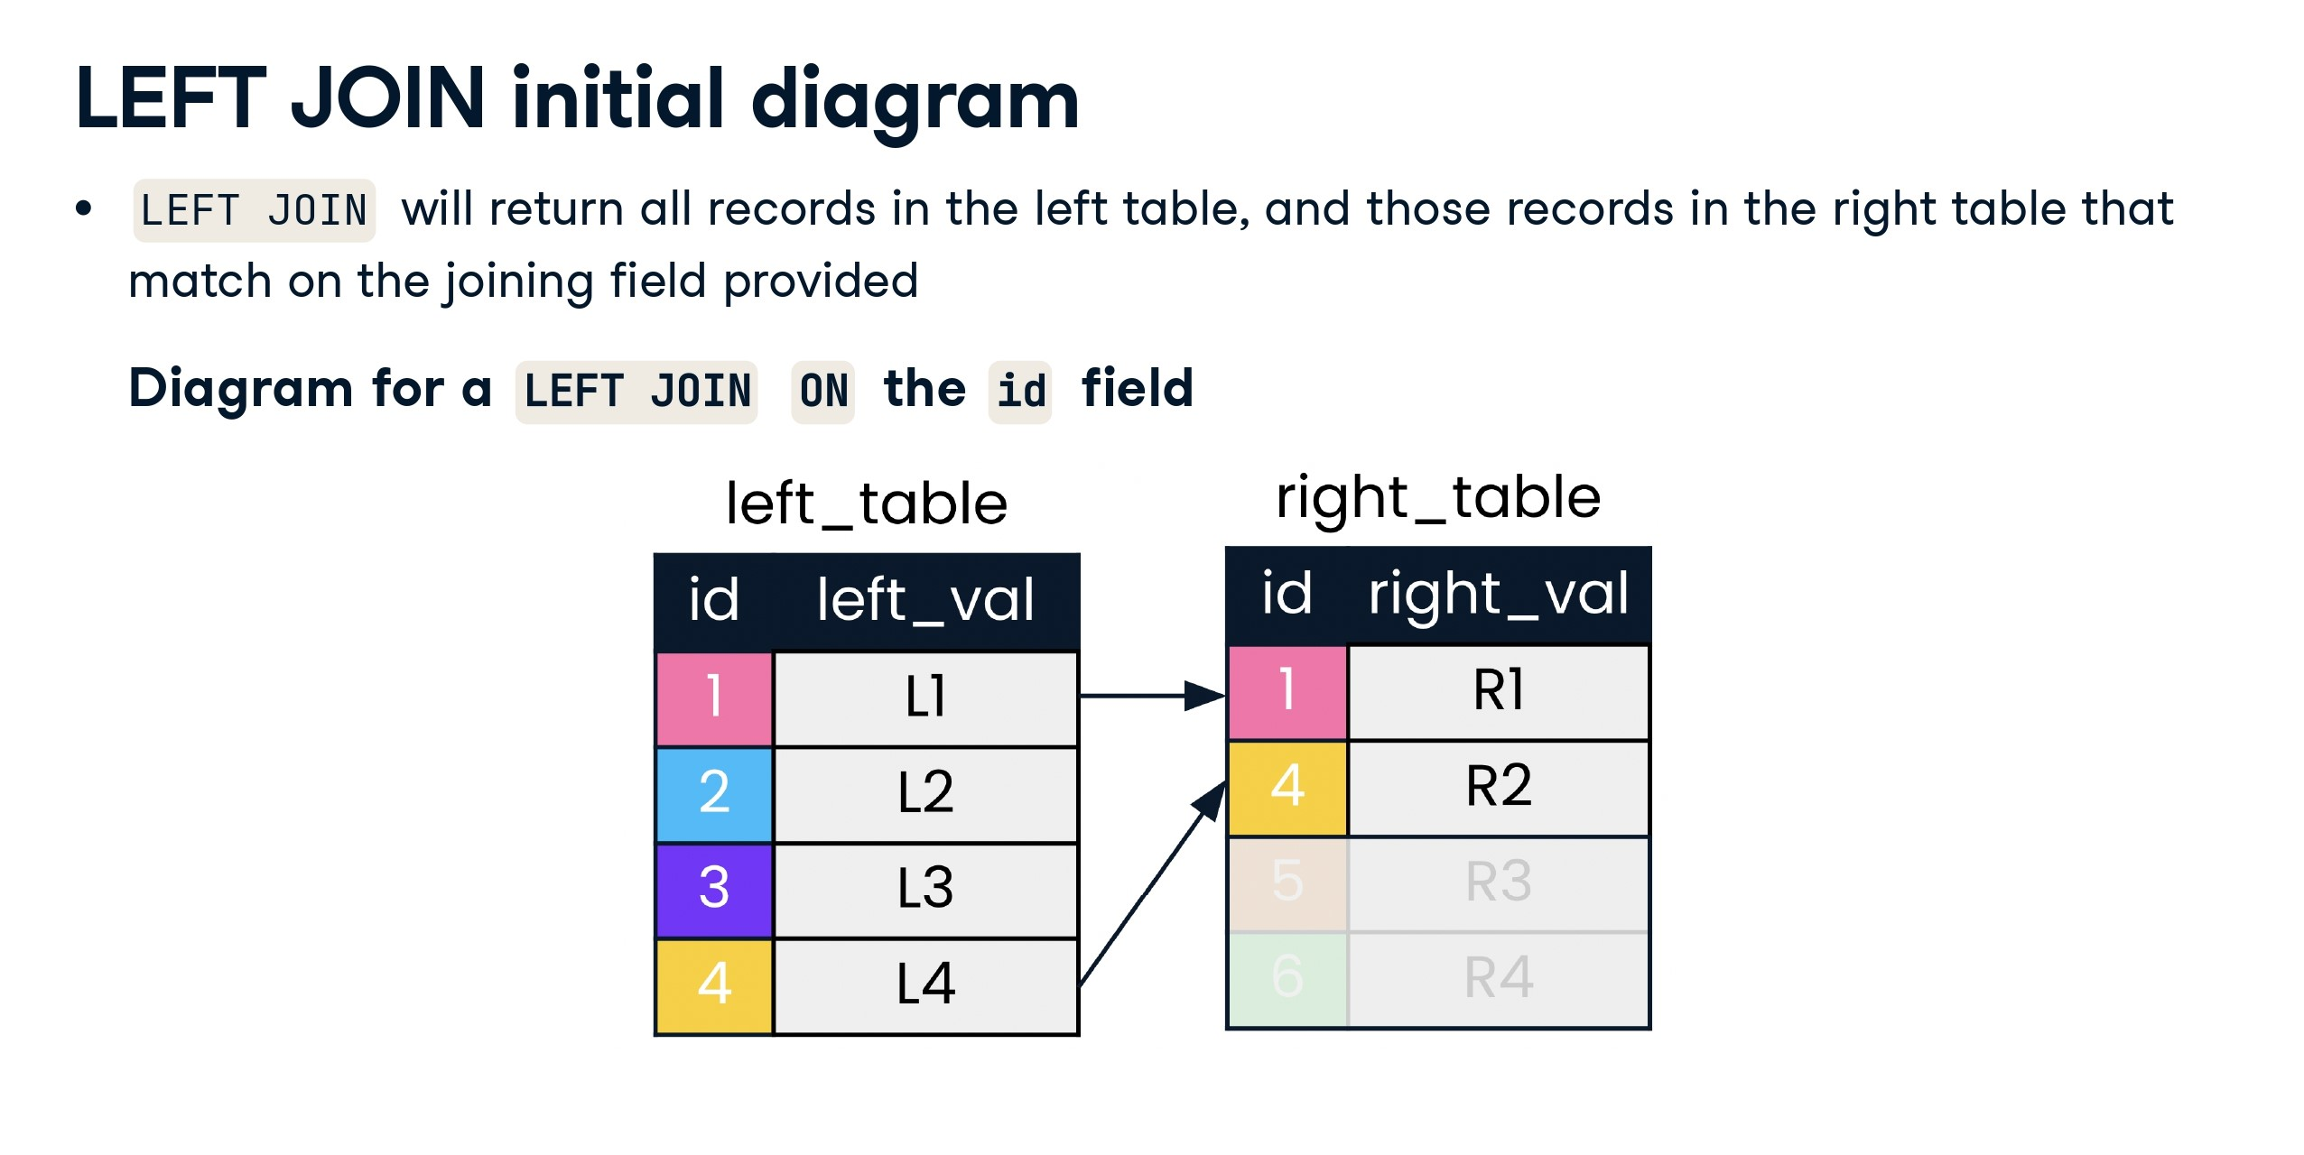

Slide 28
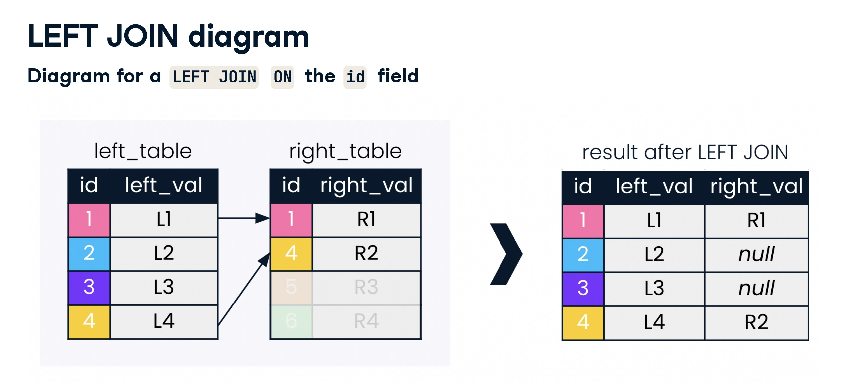

Slide 29
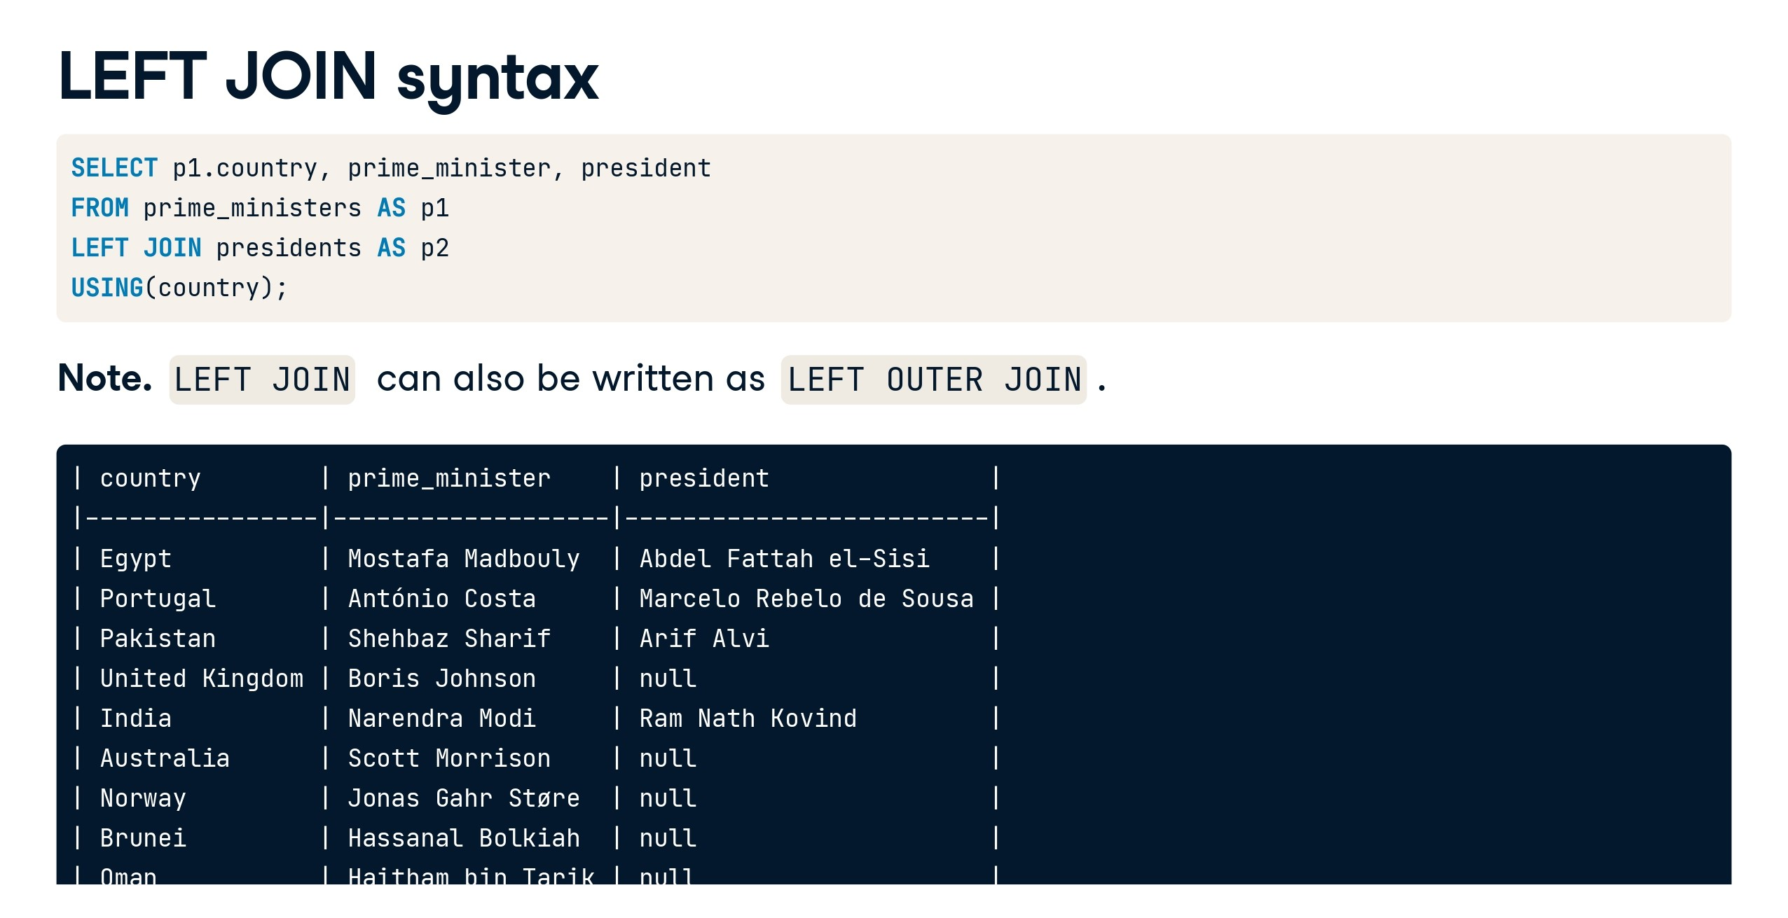

Slide 30
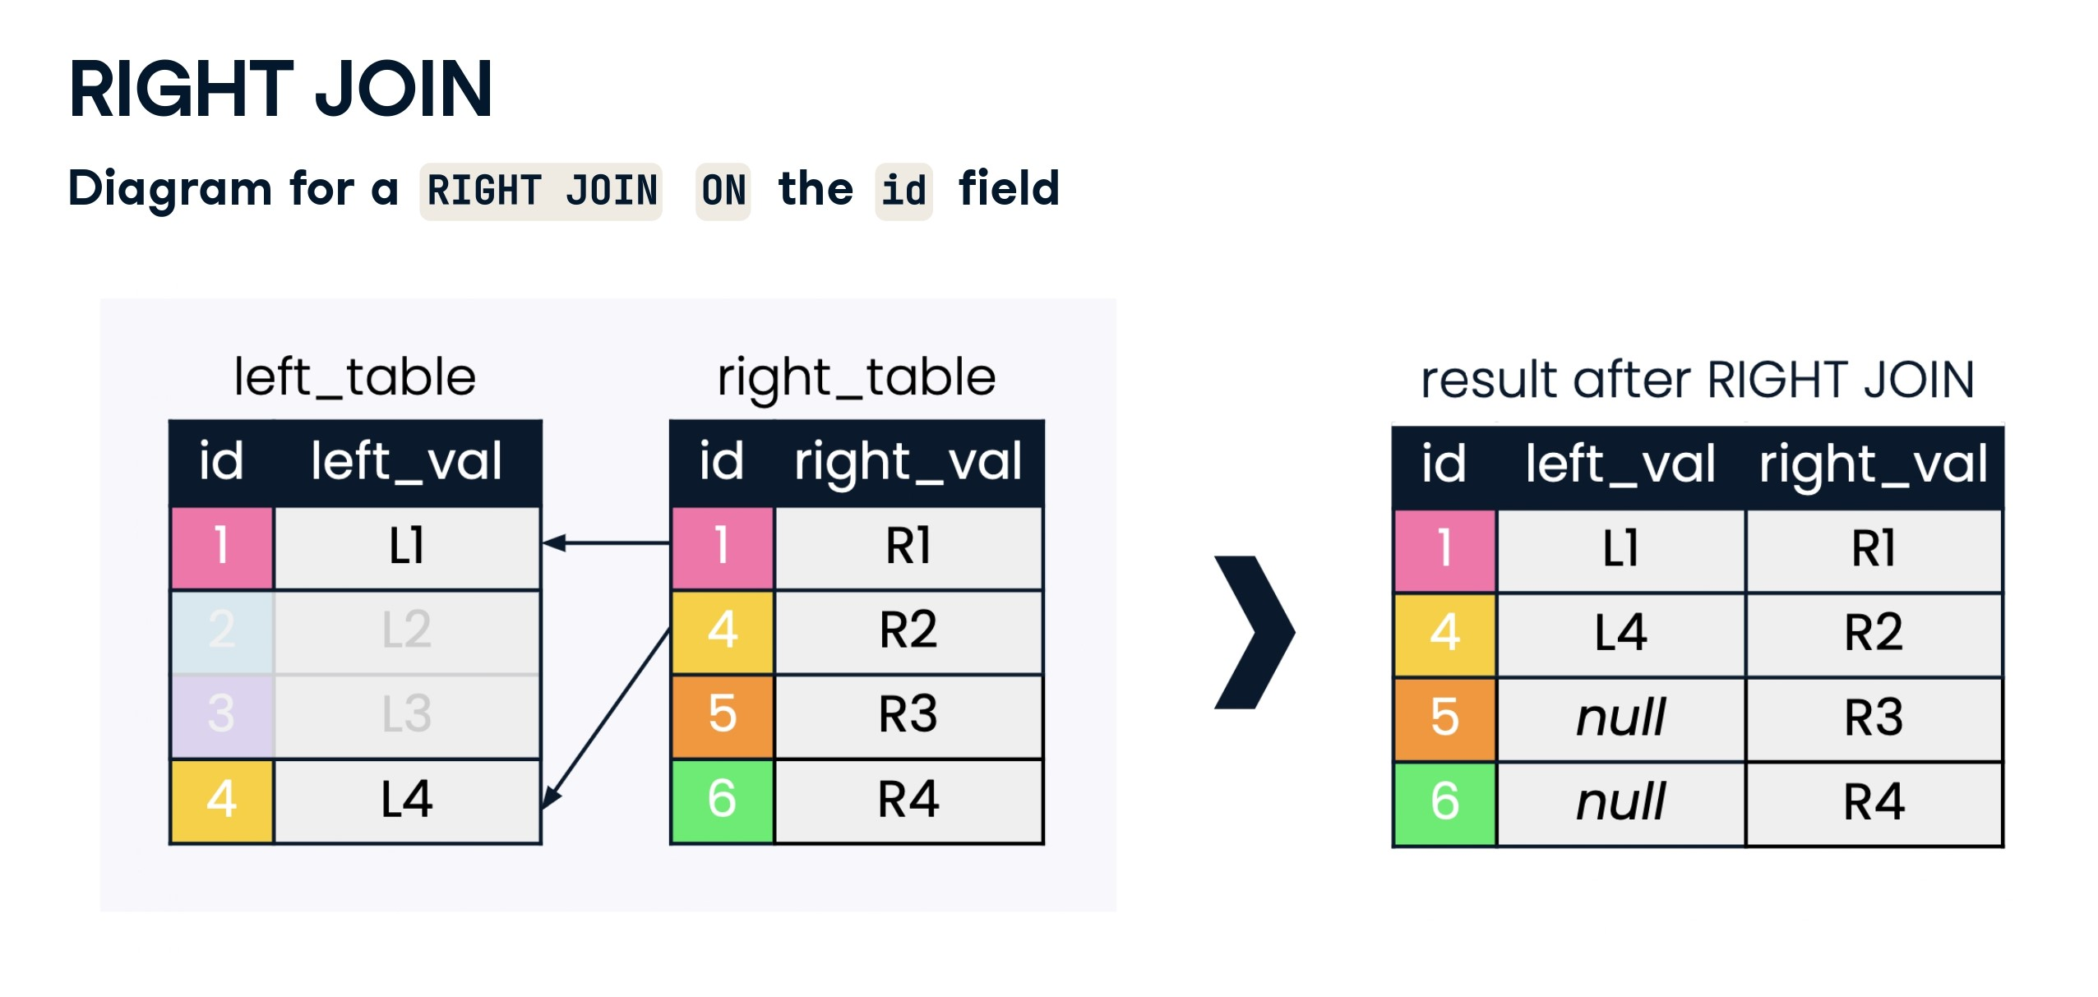

Slide 31
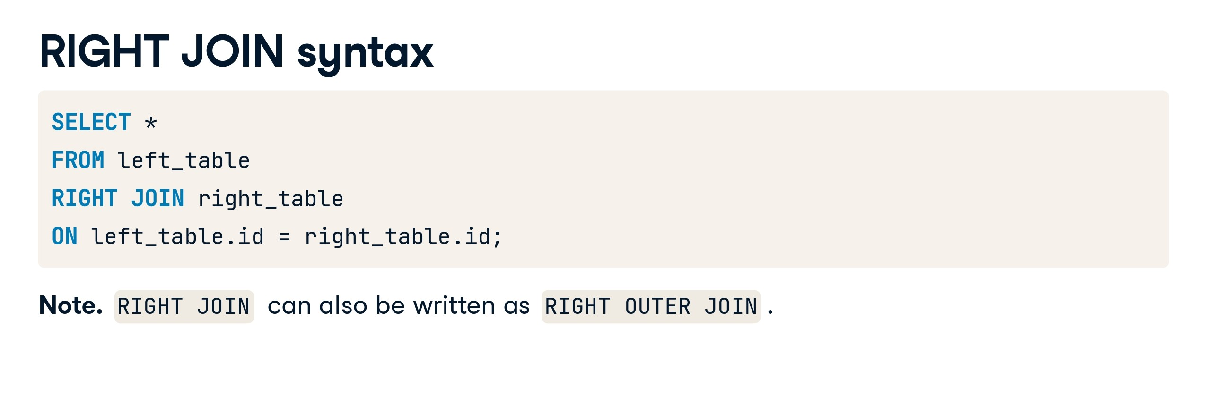

Slide 32
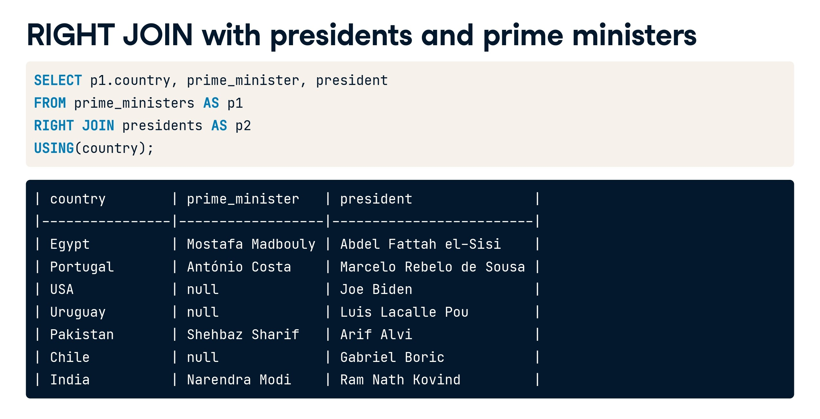

Slide 33
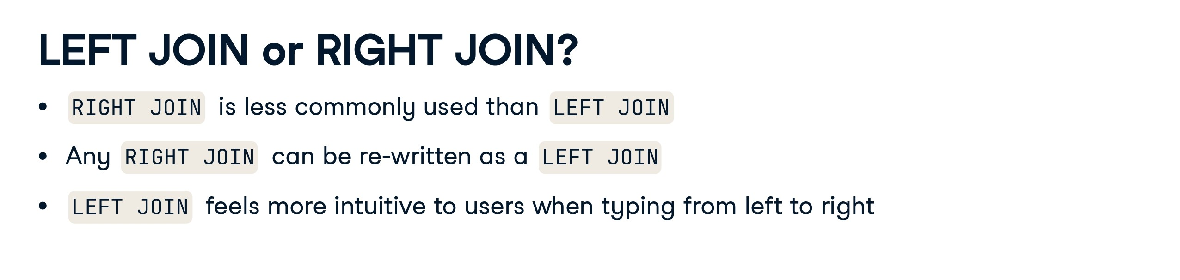

Slide 34


Slide 35


Slide 36
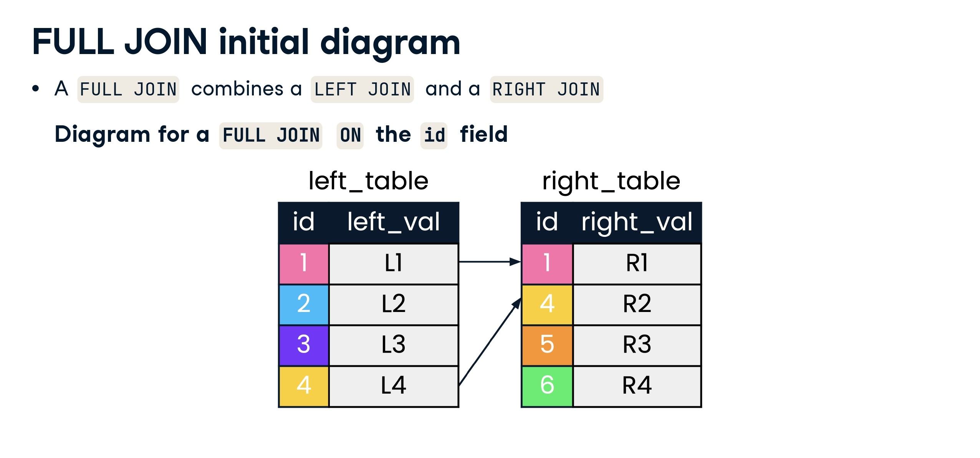

Slide 37
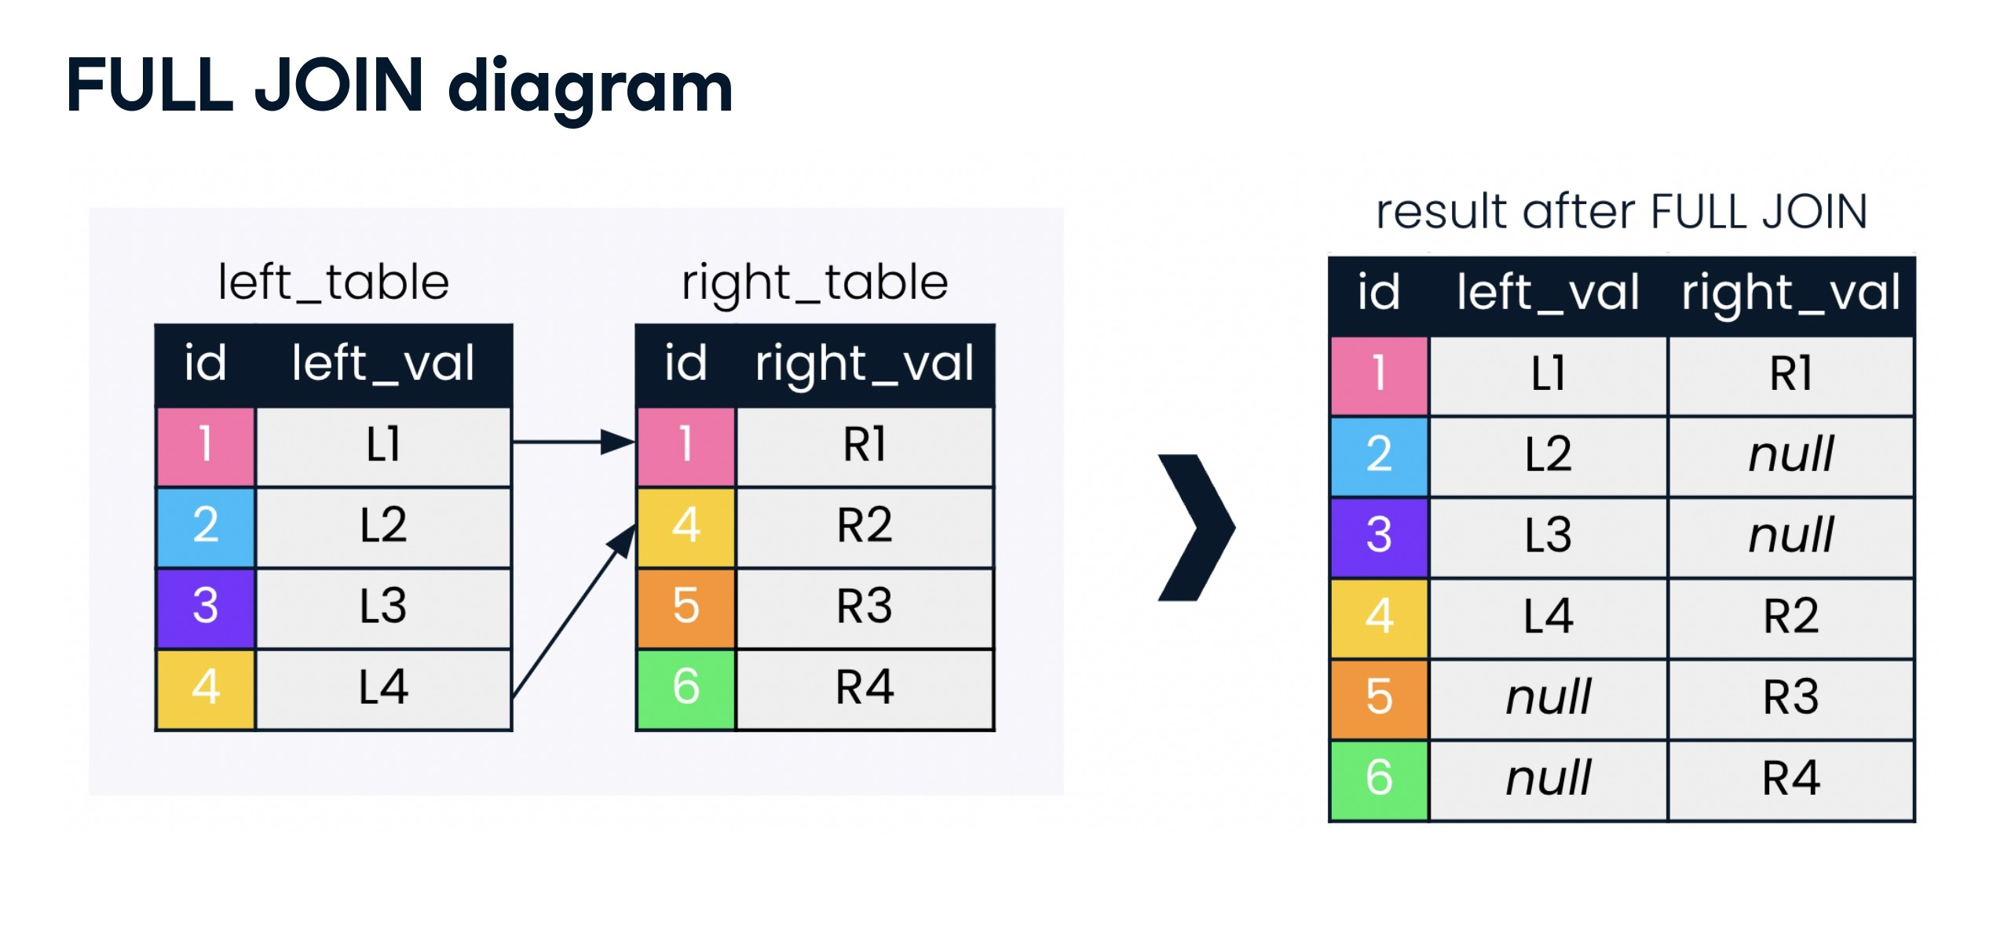

Slide 38
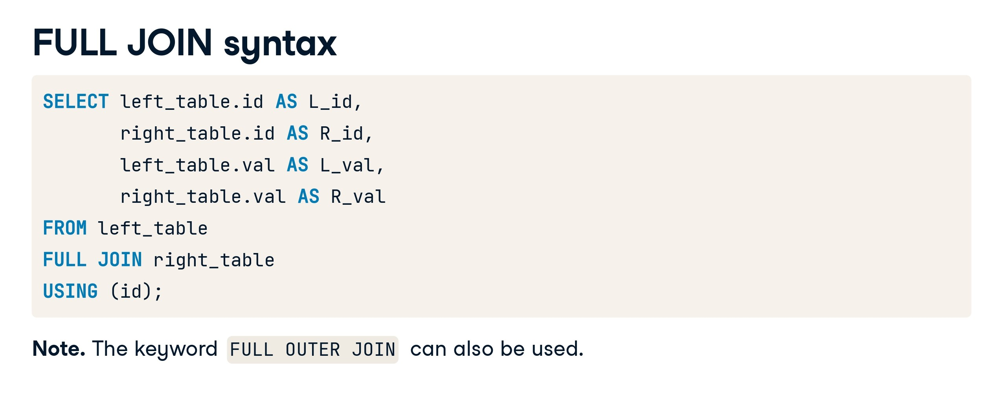

Slide 39
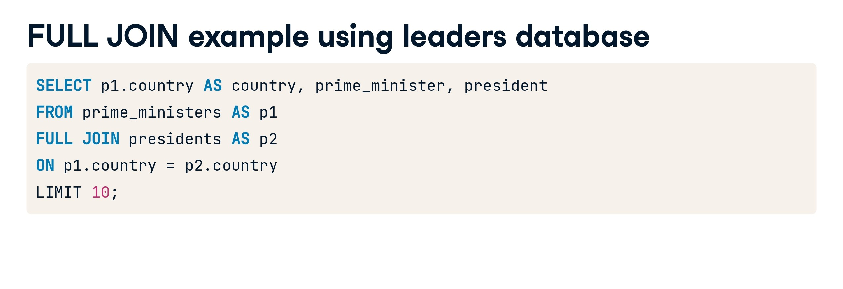

Slide 40
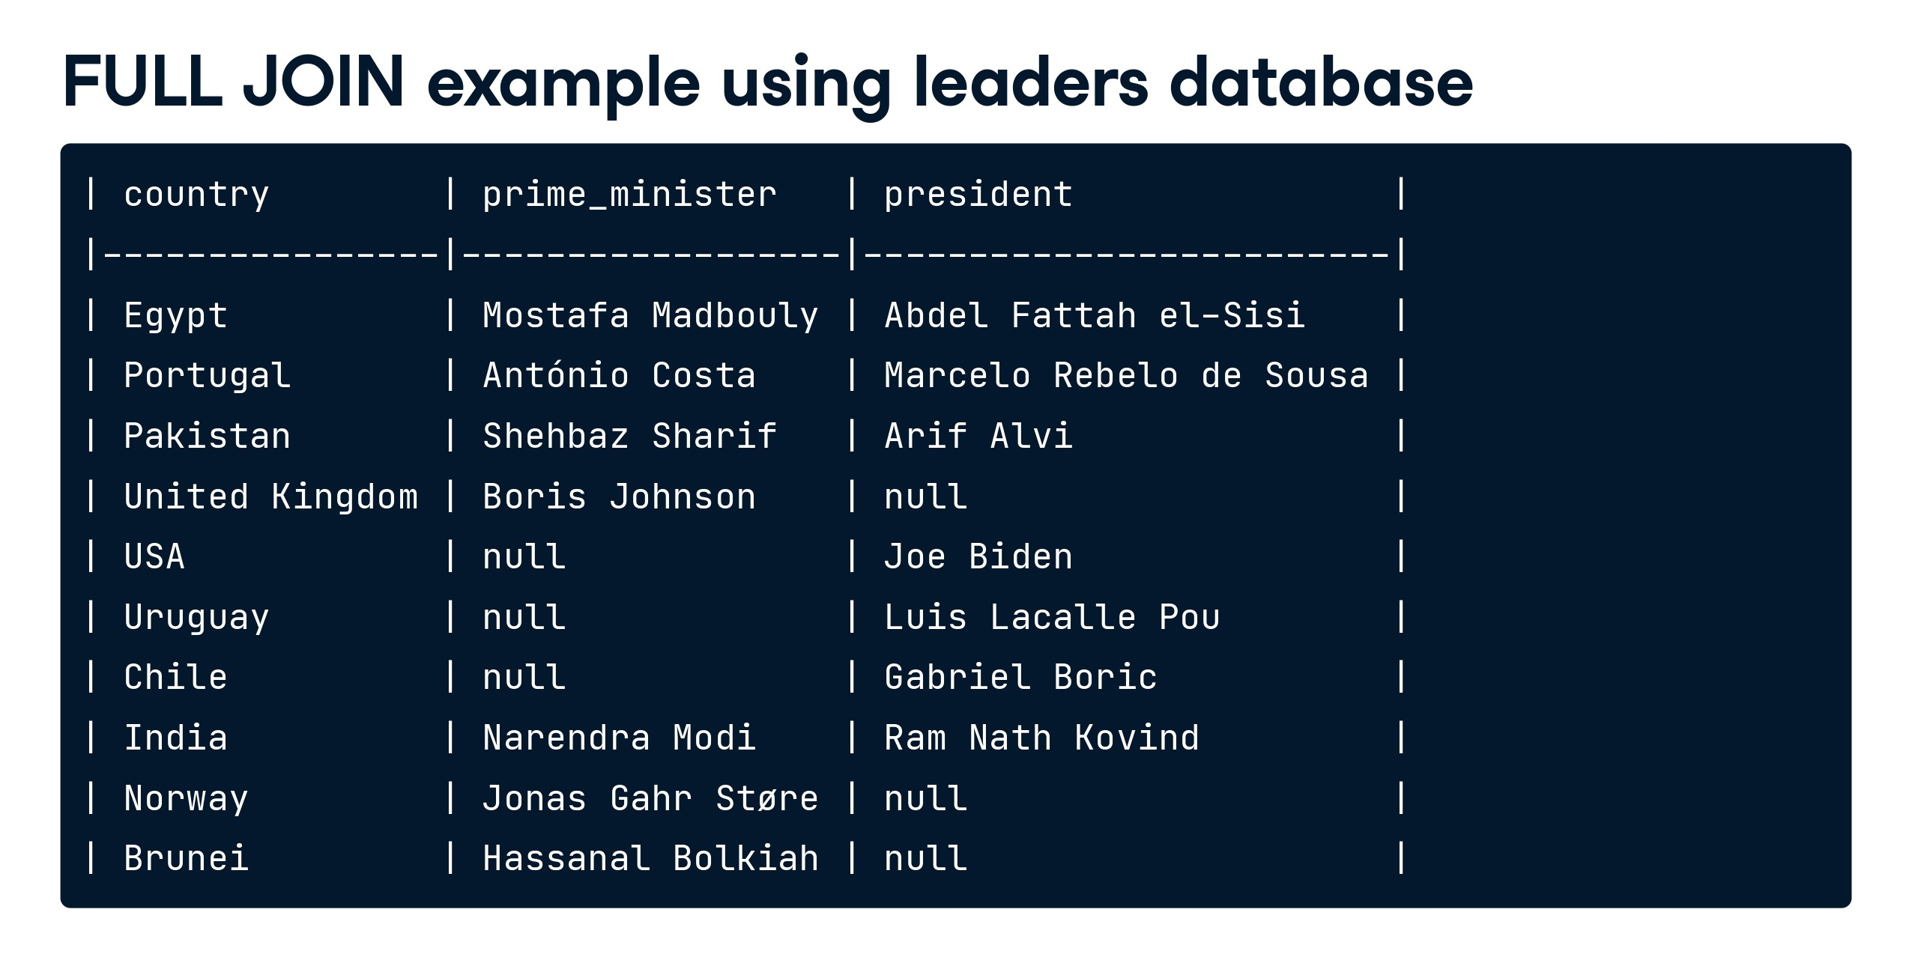

Slide 41


Slide 42


Slide 43
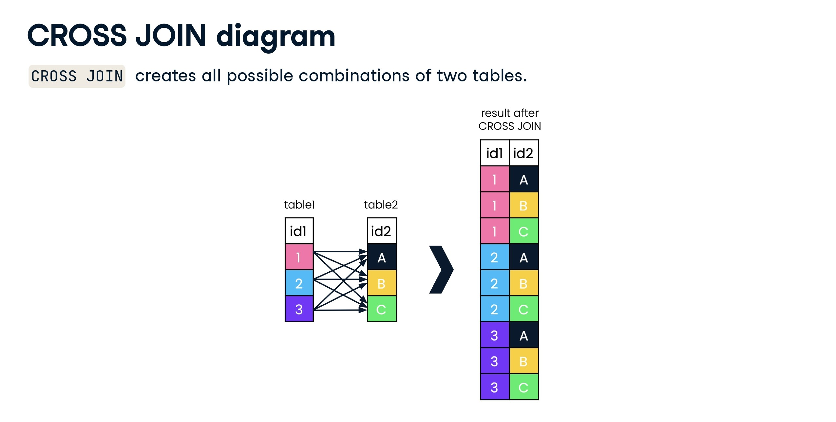

Slide 44
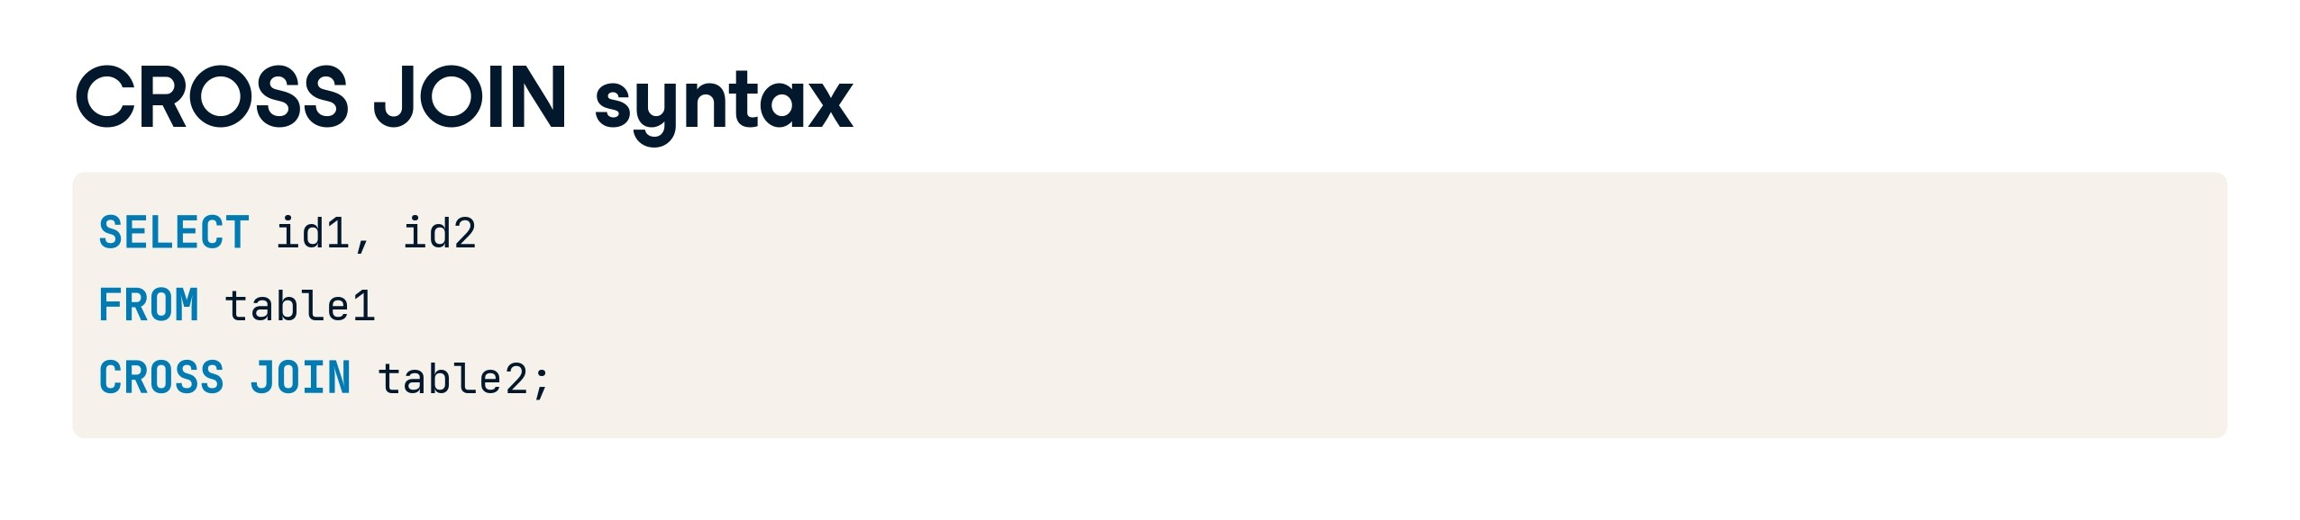

Slide 45
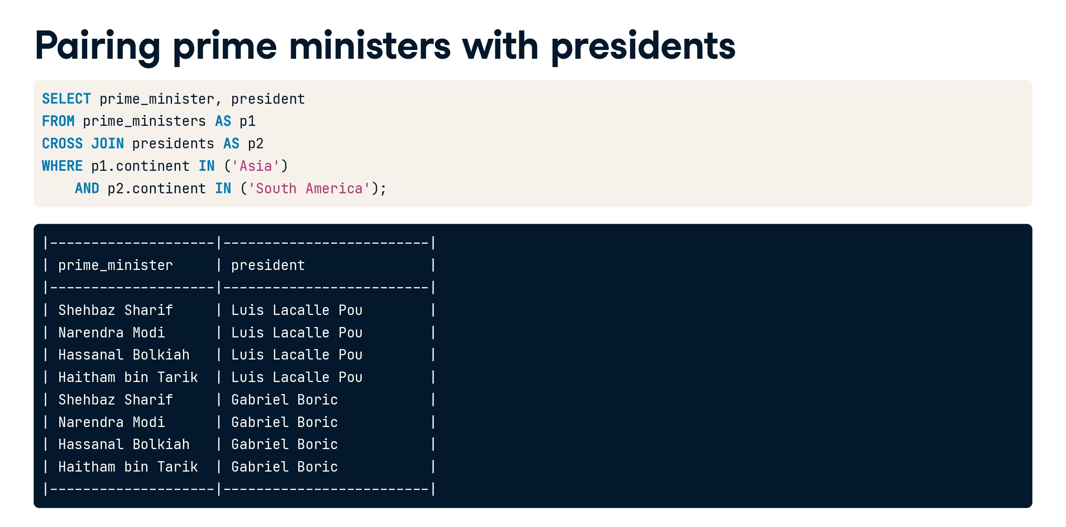

Slide 46


Slide 47


Slide 48
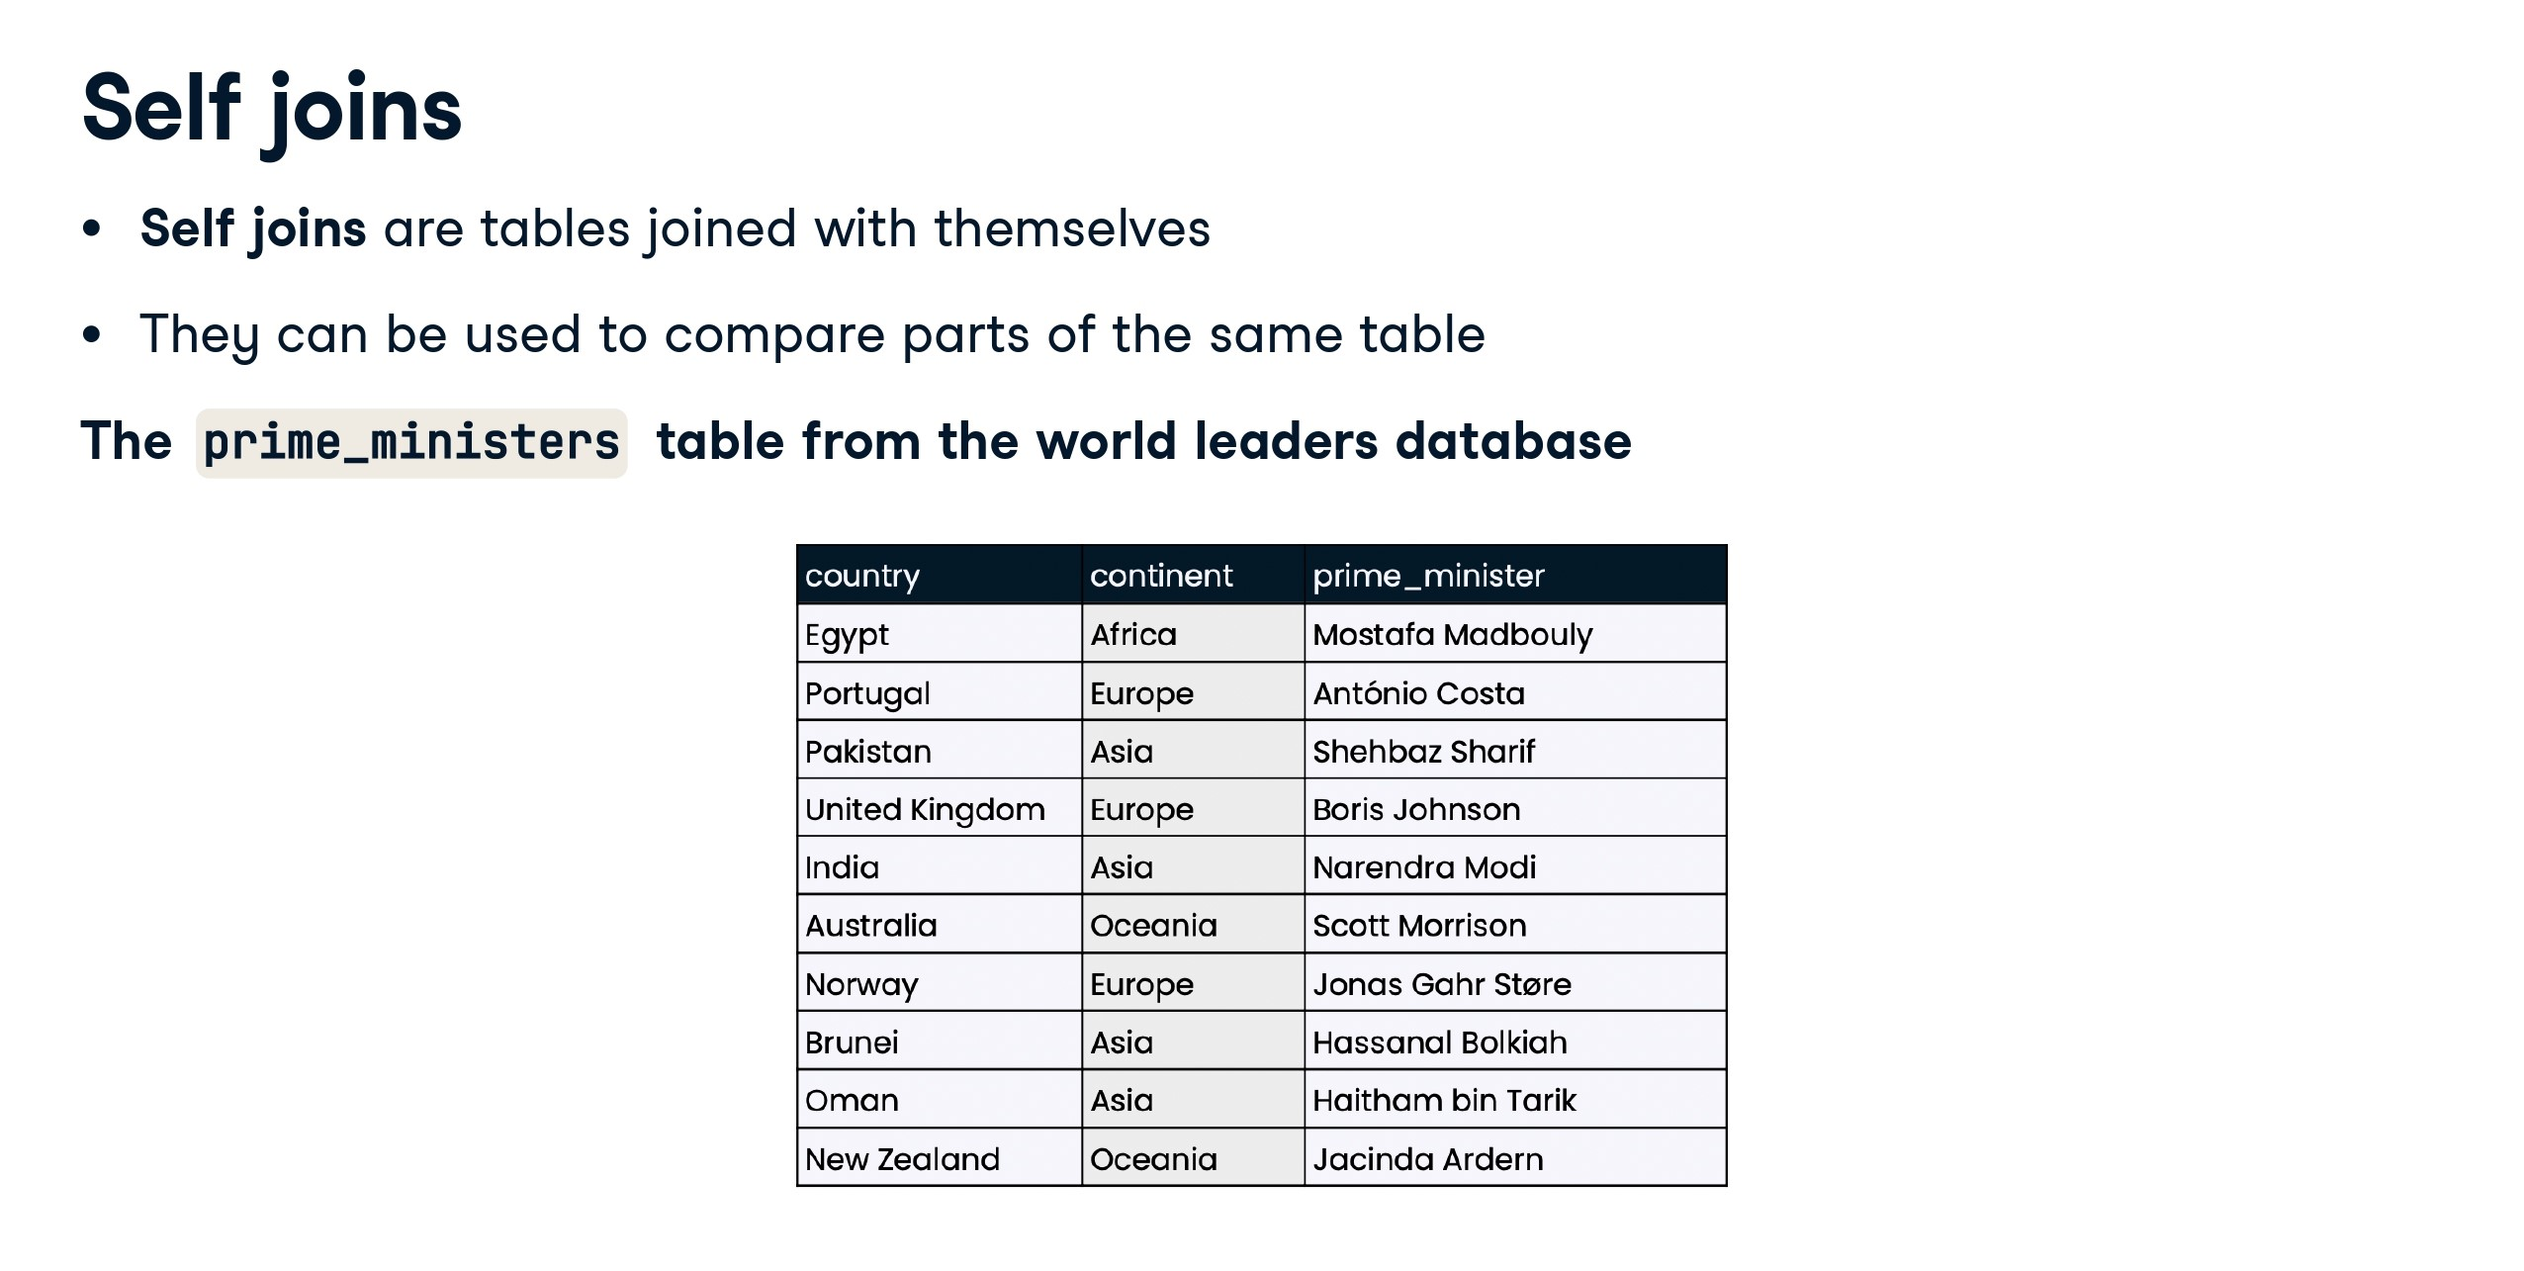

Slide 49
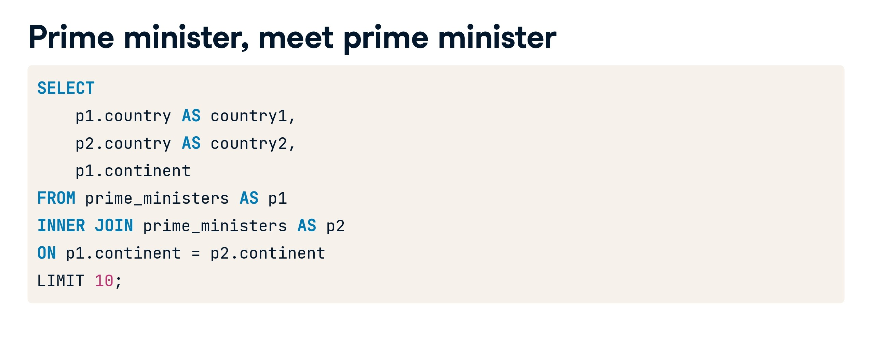

Slide 50
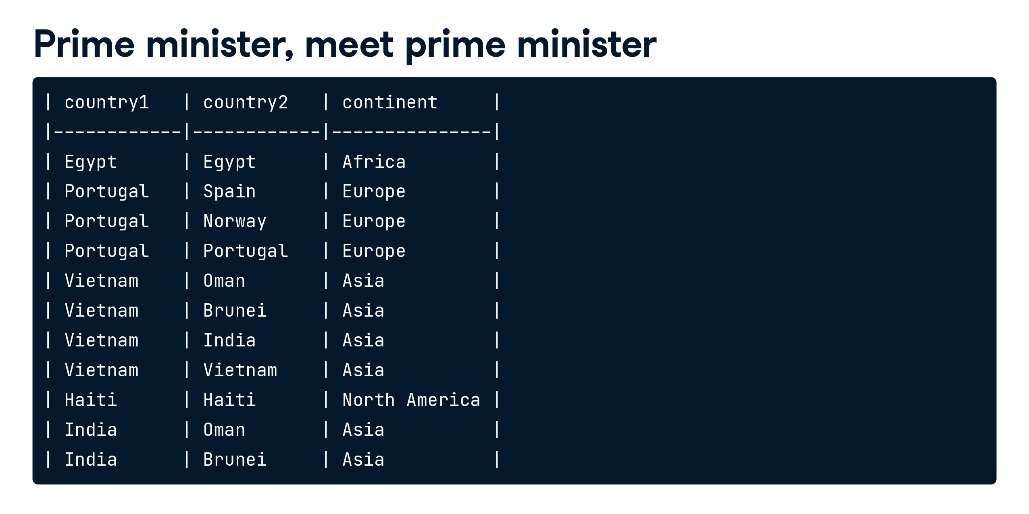

Slide 51
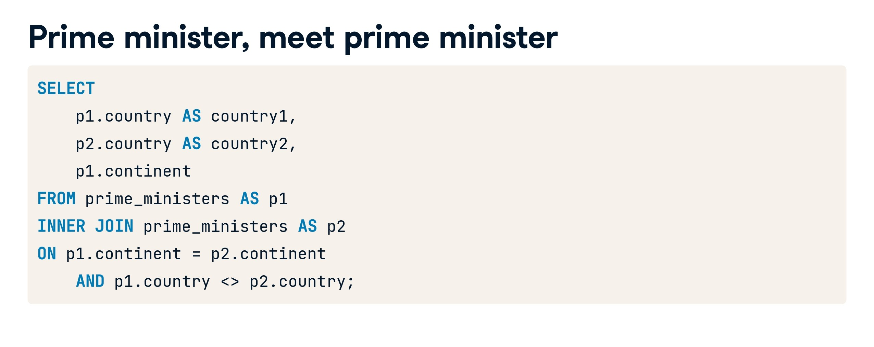

Slide 52
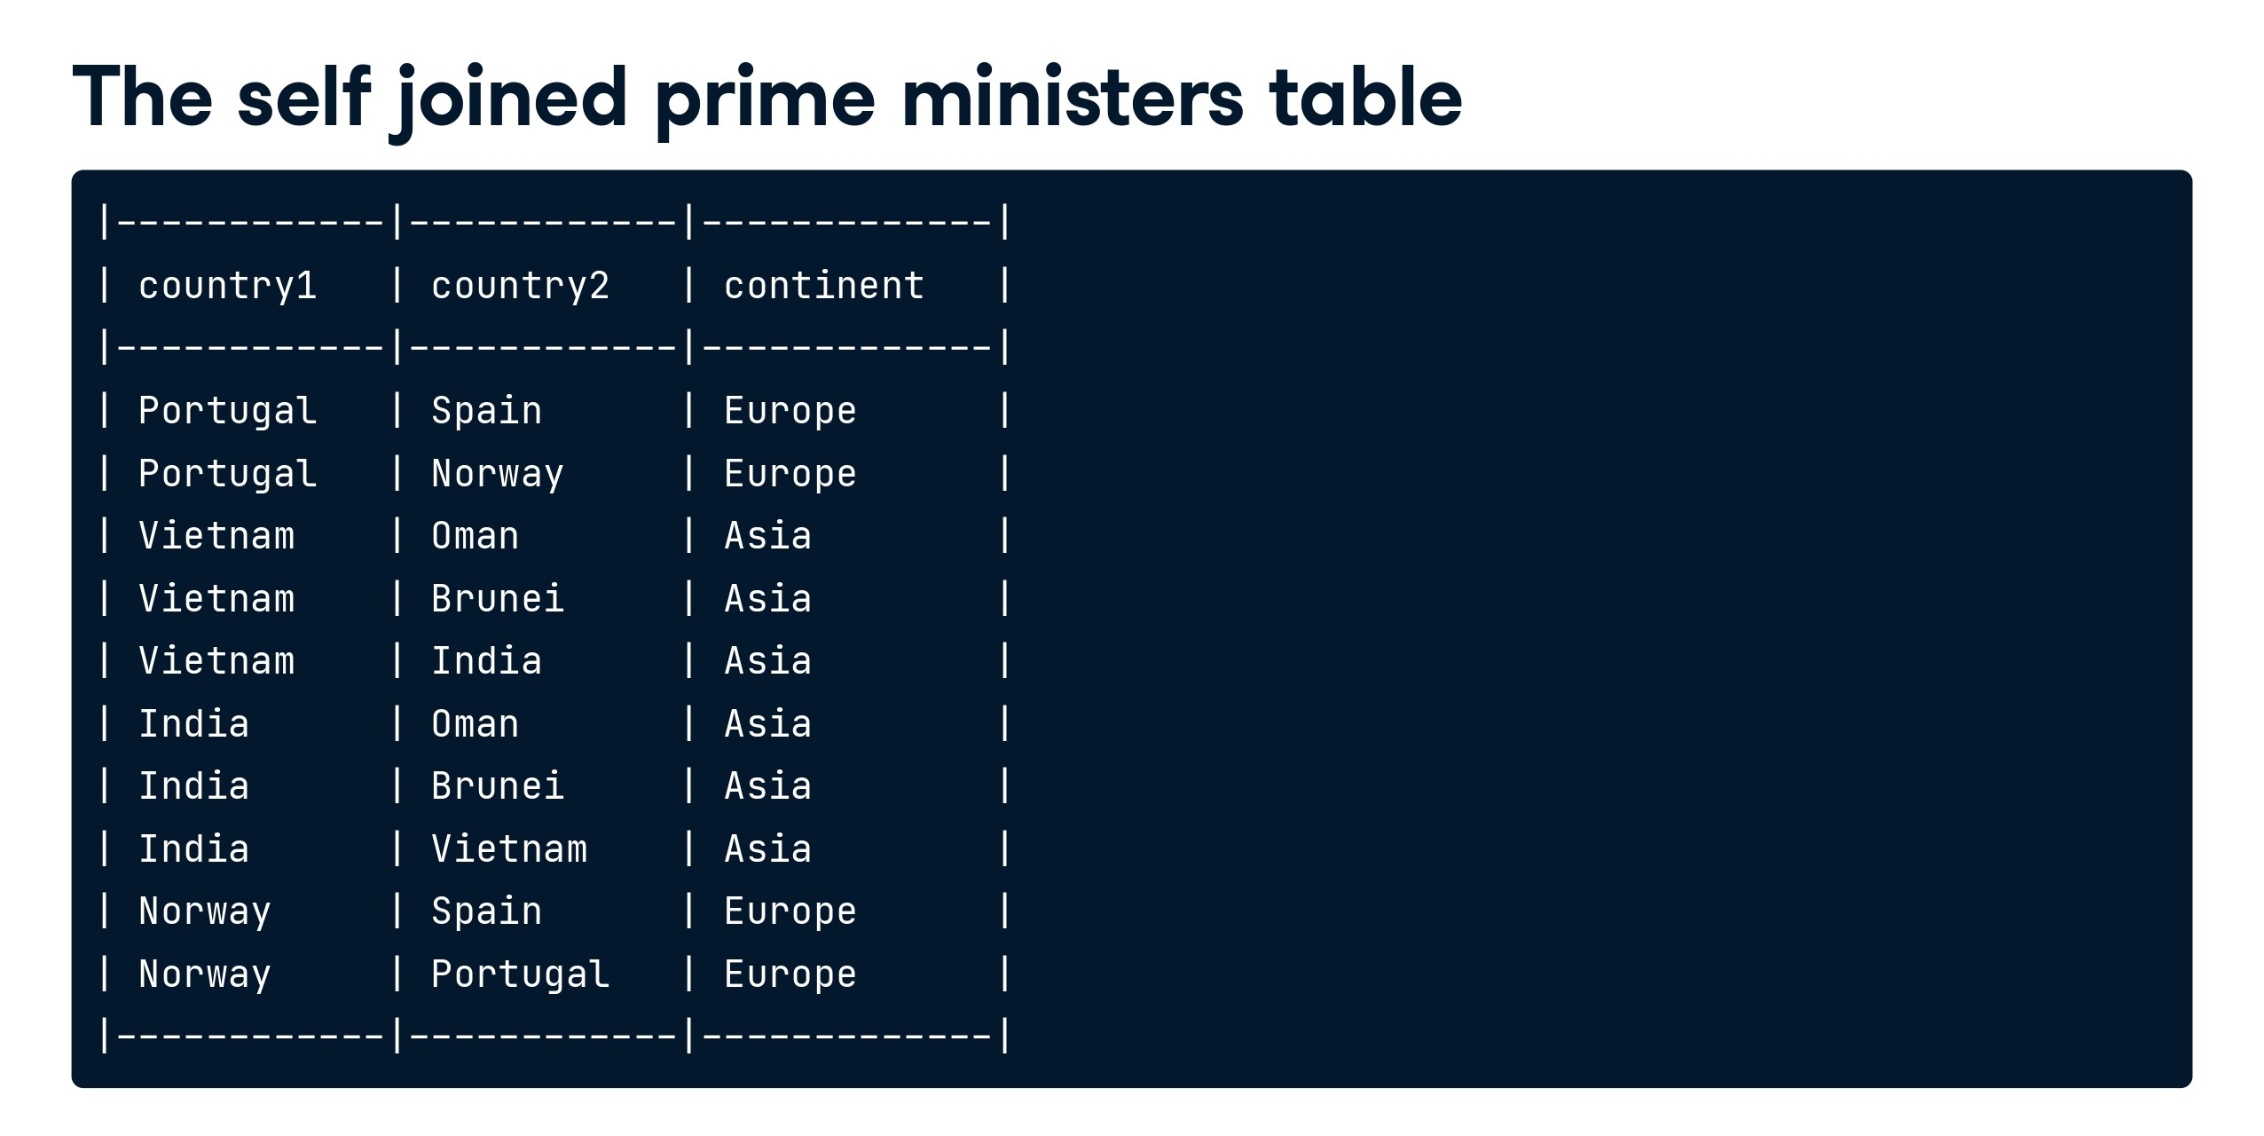

Slide 53
How many records will be there when we apply below joins. Comment down your answer in comment section below 1. inner join 2. left join 3. right join
Case Study 4:
Frequently Asked SQL Question
table A
=====
1
1
1
2
3
table B
=====
1
1
2
7
2

Slide 54
1. Inner join - 8 (intersection of both tables) 2. Left join - 8+1=9 ( intersection + unmatched records from left table) 3. Right join - 8+1 ( similar to left join)
Solution:
Frequently Asked SQL Question
table A
=====
1
1
1
2
3
table B
=====
1
1
2
7
2

Slide 55
Self Join:
-- Creating sample tables
CREATE TABLE Employees (
EmployeeID INT PRIMARY KEY,
FirstName NVARCHAR(50),
LastName NVARCHAR(50),
ManagerID INT -- ManagerID is a foreign key pointing to the EmployeeID of the manager
);
Case Study 5:
-- Inserting sample data into the Employees table
INSERT INTO Employees (EmployeeID, FirstName, LastName, ManagerID)
VALUES
(1, 'Rahul', 'Verma', NULL), -- Rahul Verma is the top-level manager (no manager)
(2, 'Priya', 'Sharma', 1), -- Priya Sharma reports to Rahul Verma
(3, 'Amit', 'Singh', 1), -- Amit Singh also reports to Rahul Verma
(4, 'Neha', 'Patel', 2), -- Neha Patel reports to Priya Sharma
(5, 'Vikas', 'Yadav', 2); -- Vikas Yadav also reports to Priya Sharma

Slide 56
Case Study 5 continue…:
-- Self Join Example: Retrieve employees along with their manager names
SELECT emp.FirstName AS EmployeeName,
emp.LastName AS EmployeeLastName,
mgr.FirstName AS ManagerName,
mgr.LastName AS ManagerLastName
FROM Employees emp
LEFT JOIN Employees mgr ON emp.ManagerID = mgr.EmployeeID;

Slide 57
Case Study 6
Select all rows from the "HumanResources.EmployeePayHistory" table where "SalariedFlag" = 0.
Include the following columns in your output:
- BusinessEntityID
- Rate
- Amount Per Paycheck - This is a derived column you will calculate - assuming a 40 hour work week - using the employee pay rate from the "Rate" column, and pay frequency from the "PayFrequency" column.
*/

Slide 58
Case Study 6
Select all rows from the "HumanResources.EmployeePayHistory" table where "SalariedFlag" = 0.
Include the following columns in your output:
- BusinessEntityID
- Rate
- Amount Per Paycheck - This is a derived column you will calculate - assuming a 40 hour work week - using the employee pay rate from the "Rate" column, and pay frequency from the "PayFrequency" column.
*/
SELECT [BusinessEntityID]
,[Rate]
,[Amount Per Paycheck] = ([Rate] * 40) * [PayFrequency]
FROM [AdventureWorks2022].[HumanResources].[EmployeePayHistory]
ORDER BY [Amount Per Paycheck] DESC

Slide 59
Case Study 7
/*
Use date math in conjunction with GETDATE to calculate what date is 100 days from now.
*/

Slide 60
Case Study 7
/*
Use date math in conjunction with GETDATE to calculate what date is 100 days from now.
*/
SELECT GETDATE() + 100

Slide 61
Case Study 8
/*
Use DATEADD to calculate what date is 6 months from now.
*/

Slide 62
Case Study 8
/*
Use DATEADD to calculate what date is 6 months from now.
*/
SELECT DATEADD(MONTH, 6, GETDATE())

Slide 63
Case Study 9
/*
Use DATEDIFF to select all rows from the "Sales.SalesOrderHeader" table
where the order date is 7 or less days before 12/25/2013.
Note that it is possible for DATEDIFF to output a negative number
if the "end" date is prior to your "start" date,
so you may want to use BETWEEN instead of <= in your criteria.
You may select all columns via the SELECT * shorthand.
*/

Slide 64
DATEFROMPARTS
DATEFROMPARTS returns a date value, with the date portion set to the specified year, month and day, and the time portion set to the default.
This function accepts three parameters namely year, month and day.
This function cannot include any time with the stated date.
DECLARE @year Int; SET @year = 2012; SELECT DATEFROMPARTS(@year, 09, 13);
Using DATEFROMPARTS() function with three variables and getting the date specified.
DECLARE @year Int;
DECLARE @month Int;
DECLARE @day Int;
SET @year = 2016;
SET @month = 08;
SET @day = 29;
SELECT DATEFROMPARTS(@year, @month, @day);

Slide 65
Case Study 9
/*
Use DATEDIFF to select all rows from the "Sales.SalesOrderHeader" table
where the order date is 7 or less days before 12/25/2013.
Note that it is possible for DATEDIFF to output a negative number
if the "end" date is prior to your "start" date,
so you may want to use BETWEEN instead of <= in your criteria.
You may select all columns via the SELECT * shorthand.
*/
SELECT
*
FROM [AdventureWorks2022].[Sales].[SalesOrderHeader]
WHERE DATEDIFF(DAY, [OrderDate], DATEFROMPARTS(2013,12,25)) BETWEEN 0 AND 7

Slide 66
Case Study 10
/*
Modify your query from Previous Question to work for ANY year, not just 2013.
HINT - instead of hardcoding the year in your DATEFROMPARTS function,
you will probably want to calculate the year based on the order date.
*/

Slide 67
Case Study 10
/*
Modify your query from Previous Question to work for ANY year, not just 2013.
HINT - instead of hardcoding the year in your DATEFROMPARTS function,
you will probably want to calculate the year based on the order date.
*/
SELECT
*
FROM [AdventureWorks2022].[Sales].[SalesOrderHeader]
WHERE DATEDIFF(DAY, [OrderDate], DATEFROMPARTS(YEAR([OrderDate]),12,25)) BETWEEN 0 AND 7

Slide 68
Case Study 11
/*
Select all records from the "Purchasing.PurchaseOrderHeader" table where
the order date occurred between 1/1/2011 and 7/31/2011 AND
the total amount due is greater than $10,000.
Include the following columns:
- PurchaseOrderID
- OrderDate
- TotalDue
*/

Slide 69
Case Study 11
/*
Select all records from the "Purchasing.PurchaseOrderHeader" table where
the order date occurred between 1/1/2011 and 7/31/2011 AND
the total amount due is greater than $10,000.
Include the following columns:
- PurchaseOrderID
- OrderDate
- TotalDue
*/
SELECT [PurchaseOrderID]
,[OrderDate]
,[TotalDue]
FROM [AdventureWorks2022].[Purchasing].[PurchaseOrderHeader]
WHERE [OrderDate] BETWEEN DATEFROMPARTS(2011, 1, 1) AND DATEFROMPARTS(2011, 7, 31)
AND [TotalDue] > 10000

Slide 70
Case Study 12
Write a query against the Purchasing.PurchaseOrderHeader table that includes the following fields:
• OrderYearMonth
o This field should be a reformatted version of the “OrderDate” field, in which the date values are converted to strings consisting of the 4 digit year, a hyphen, and the 2 digit month. For example, the date “2013-04-20” would be converted to the string “2012-04”.
• TaxAmt
o This field should be formatted as currency (specifying culture/locale is optional).
• Freight
o This field should be formatted as currency (specifying culture/locale is optional).
• TotalDue
o This field should be formatted as currency (specifying culture/locale is optional).
Your query output should only include records from the PurchaseOrderHeader table where the order date was in 2013.

Slide 71
Case Study 12
Write a query against the Purchasing.PurchaseOrderHeader table that includes the following fields:
• OrderYearMonth
o This field should be a reformatted version of the “OrderDate” field, in which the date values are converted to strings consisting of the 4 digit year, a hyphen, and the 2 digit month. For example, the date “2013-04-20” would be converted to the string “2012-04”.
• TaxAmt
o This field should be formatted as currency (specifying culture/locale is optional).
• Freight
o This field should be formatted as currency (specifying culture/locale is optional).
• TotalDue
o This field should be formatted as currency (specifying culture/locale is optional).
Your query output should only include records from the PurchaseOrderHeader table where the order date was in 2013.
SELECT TaxAmt,
OrderYearMonth = FORMAT(OrderDate, 'yyyy - MM')
,TaxAmt = FORMAT(TaxAmt, 'c')
,Freight = FORMAT(Freight, 'c')
,TotalDue = FORMAT(TotalDue, 'c')
FROM AdventureWorks2022.Purchasing.PurchaseOrderHeader
WHERE YEAR(OrderDate) = 2013

Slide 72
Case Study 13
/*
Display the count of products in the Production.Product table, broken out by color.
*/

Slide 73
Case Study 13
/*
Display the count of products in the Production.Product table, broken out by color.
*/
SELECT
[Color],
[ProductCount] = Count(*)
FROM [AdventureWorks2022].[Production].[Product]
GROUP BY [Color]

Slide 74
Case Study 14
/*
Modify your code from previous Exercise by breaking out the product count by color AND style.
Then add a new column with the sum of the list prices for each group.
*/

Slide 75
Case Study 14
/*
Modify your code from previous Exercise by breaking out the product count by color AND style.
Then add a new column with the sum of the list prices for each group.
*/
SELECT
[Color],
[Style],
[ProductCount] = Count(*),
[ListPriceTotal] = SUM([ListPrice])
FROM [AdventureWorks2022].[Production].[Product]
GROUP BY [Color], [Style]

Slide 76
Case Study 15
/*
Identify all first names in the Person.Person table which are shared by more than 50 people.
Sort the output in descending order by the count of the name.
*/

Slide 77
Case Study 15
/*
Identify all first names in the Person.Person table which are shared by more than 50 people.
Sort the output in descending order by the count of the name.
*/
SELECT
[FirstName],
[Count] = COUNT(*)
FROM [AdventureWorks2022].[Person].[Person]
GROUP BY [FirstName]
HAVING COUNT(*) > 50
ORDER BY 2 DESC

Slide 78


Slide 79
End of Day 4
Any Query?

